Slide 1
Searching Algorithm on Arrays

Slide 2
Searching Algorithm on Arrays
Linear Search
Sentinel Linear Search
Binary Search
Meta Binary Search | One-Sided Binary Search
Ternary Search
Jump Search
Interpolation Search
Exponential Search
Fibonacci Search
The Ubiquitous Binary Search

Slide 3
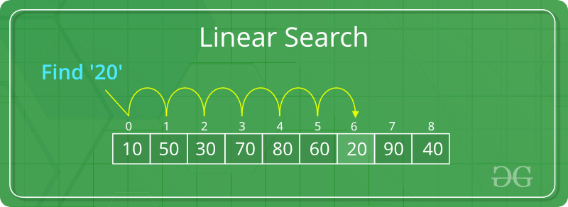
Linear Search Algorithm
Linear Search is defined as a sequential search algorithm that starts at one end and goes through each element of a list until the desired element is found, otherwise the search continues till the end of the data set
How Does Linear Search Algorithm Work?
In Linear Search Algorithm,
Every element is considered as a potential match for the key and checked for the same.
If any element is found equal to the key, the search is successful and the index of that element is returned.
If no element is found equal to the key, the search yields “No match found”.
For example: Consider the array arr[] = {10, 50, 30, 70, 80, 20, 90, 40} and key = 30

Slide 4
Linear Search Algorithm
public class Linear {
public static int search(int arr[], int N, int x)
{
for (int i = 0; i < N; i++) {
if (arr[i] == x)
return i;
}
return -1;
}
// Driver code
public static void main(String args[])
{
int arr[] = { 2, 3, 4, 10, 40 };
int x = 1;
// Function call
int result = search(arr, arr.length, x);
if (result == -1)
System.out.print(
"Element is not present in array");
else
System.out.print("Element is present at index "
+ result);
}
}

Slide 5
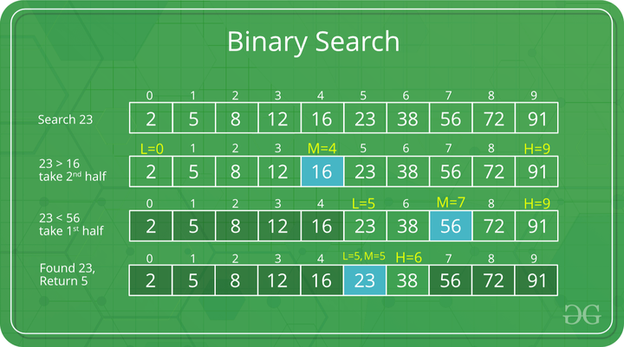
Binary Search
Binary Search is defined as a searching algorithm used in a sorted array by repeatedly dividing the search interval in half. The idea of binary search is to use the information that the array is sorted and reduce the time complexity to O(log N).

Slide 6
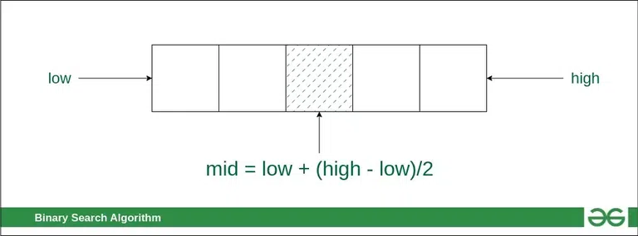
Binary Search
Conditions for when to apply Binary Search in a Data Structure:
To apply Binary Search algorithm:
The data structure must be sorted.
Access to any element of the data structure takes constant time
Compare the middle element of the search space with the key.
If the key is found at middle element, the process is terminated.
If the key is not found at middle element, choose which half will be used as the next search space.
If the key is smaller than the middle element, then the left side is used for next search.
If the key is larger than the middle element, then the right side is used for next search.
This process is continued until the key is found or the total search space is exhausted.

Slide 7
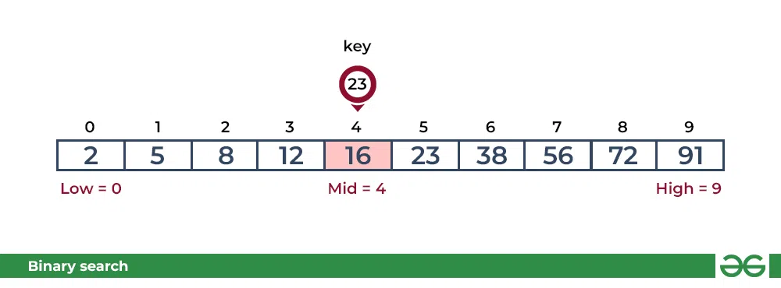
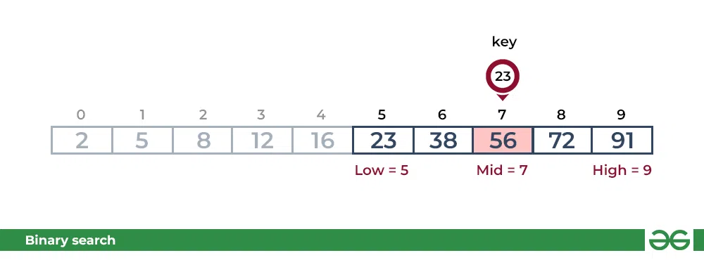
Consider an array arr[] = {2, 5, 8, 12, 16, 23, 38, 56, 72, 91}, and the target = 23.
First Step: Calculate the mid and compare the mid element with the key. If the key is less than mid element, move to left and if it is greater than the mid then move search space to the right.
Key (i.e., 23) is greater than current mid element (i.e., 16). The search space moves to the right.
Key is less than the current mid 56. The search space moves to the left.

Slide 8
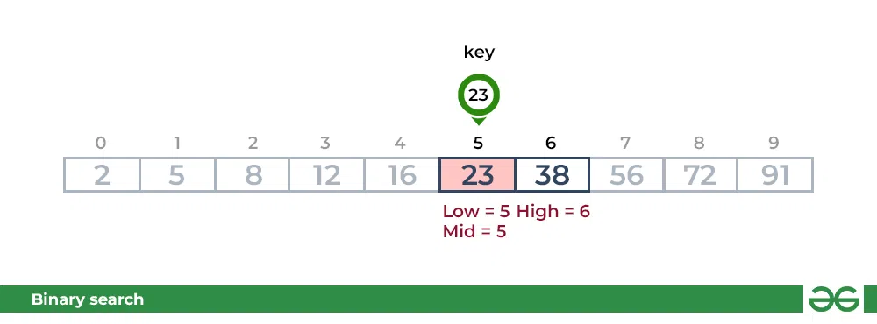
Second Step: If the key matches the value of the mid element, the element is found and stop search

Slide 9
class Binary {
// Returns index of x if it is present in arr[].
int binarySearch(int arr[], int x)
{
int l = 0, r = arr.length - 1;
while (l <= r) {
int m = l + (r - l) / 2;
// Check if x is present at mid
if (arr[m] == x)
return m;
// If x greater, ignore left half
if (arr[m] < x)
l = m + 1;
// If x is smaller, ignore right half
else
r = m - 1;
}
// If we reach here, then element was
// not present
return -1;
}
// Driver code
public static void main(String args[])
{
Binary ob = new Binary();
int arr[] = { 2, 3, 4, 10, 40 };
int n = arr.length;
int x = 10;
int result = ob.binarySearch(arr, x);
if (result == -1)
System.out.println(
"Element is not present in array");
else
System.out.println("Element is present at "
+ "index " + result);
}
}

Slide 10
Exponential Search
The term Exponential generally denotes rapid growth, and mathematically it means increasing in powers.
For example:
Exponential growth of 2: 2^0, 2^1, 2^2, 2^3, 2^4 and so on => (1, 2, 4, 8, 16,…..)
Exponential growth of 3: 3^0, 3^1, 3^2, 3^3, 3^4 and so on => (1, 3, 9, 27, 81,….)
We use the same generated numbers ( powers of 2 ) to jump indexes in array and get closer to the index of key.
In this algorithm, ultimately we rely on Binary Search for searching, but before that, we finalize a range in which the element we want to search might be present.
Exponential Search also Called Doubling Search Galloping Search

Slide 11
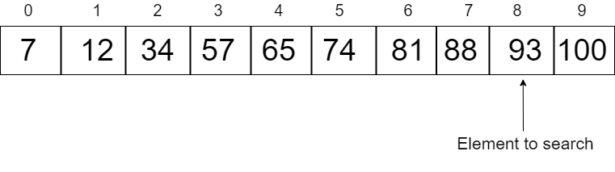
Exponential Search
We will start by comparing the first element of the array with the key.
But Array[0]=7, which is not equal to 93.
Now we will take a variable whose value will increase exponentially, hence the name, exponential search.
int i= 1 ( because 2^0=1)
Now we will see if Array[i] is less than or equal to the key.
If it is, then we will keep on increasing the value exponentially.
i=i*2
This will generate values in powers of 2. ( 2, 4, 8, 16, 32...)
We will keep on increasing the value of i, until the condition Array[i]<=key is satisfied.
So in the above example, the value of i will reach 8 (in the actual code it will reach 16, then we will divide it by 2) and the sub-array after this index will be selected (including the index of i), and then the binary search will be applied to this range.

Slide 12
import java.util.Arrays;
class Exponential
{
// Returns position of
// first occurrence of
// x in array
static int exponentialSearch(int arr[],
int n, int x)
{
// If x is present at first location itself
if (arr[0] == x)
return 0;
// Find range for binary search by
// repeated doubling
int i = 1;
while (i < n && arr[i] <= x)
i = i*2;
// Call binary search for the found range.
return Arrays.binarySearch(arr, i/2,
Math.min(i, n-1), x);
}
public static void main(String args[])
{
int arr[] = {2, 3, 4, 10, 40};
int x = 10;
int result = exponentialSearch(arr,
arr.length, x);
System.out.println((result < 0) ?
"Element is not present in array" :
"Element is present at index " +
result);
}
}

Slide 13
Sorting Array
How to Sort an Array in Java
The sorting is a way to arrange elements of a list or array in a certain order. The order may be in ascending or descending order. The numerical and lexicographical (alphabetical) order is a widely used order.
In this section, we will learn how to sort array in Java in ascending and descending order using the sort() method and without using the sort() method. Along with this, we will also learn how to sort subarray in Java.

Slide 14
Sorting Array Ascending
import java.util.Arrays;
public class Sort {
public static void main(String[] args) {
// TODO Auto-generated method stub
int [] array = new int [] {90, 23, 5, 109, 12, 22, 67, 34};
//invoking sort() method of the Arrays class
Arrays.sort(array);
System.out.println("Elements of array sorted in ascending order: ");
//prints array using the for loop
for (int i = 0; i < array.length; i++)
{
System.out.println(array[i]);
}
}
}

Slide 15
import java.util.Arrays;
public class Sort {
public static void main(String[] args) {
Sorting Array Ascending
int[] arr = new int[] {78, 34, 1, 3, 90, 34, -1, -4, 6, 55, 20, -65};
System.out.println("Array elements after sorting:");
//sorting logic
for (int i = 0; i < arr.length; i++)
{
for (int j = i + 1; j < arr.length; j++)
{
int tmp = 0;
if (arr[i] > arr[j])
{
//tmp = arr[i];
//arr[i] = arr[j];
//arr[j] = tmp;
}
}
//prints the sorted element of the array
System.out.println(arr[i]);
} }
}

Slide 16
Sorting Array Descending
In the following program, a point to be noticed that we have defined an array as Integer.
import java.util.Arrays;
import java.util.Collections;
public class SortArrayExample4
{
public static void main(String[] args)
{
Integer [] array = {23, -9, 78, 102, 4, 0, -1, 11, 6, 110, 205};
// sorts array[] in descending order
Arrays.sort(array, Collections.reverseOrder());
System.out.println("Array elements in descending order: " +Arrays.toString(array));
}
}
Output
[205, 110, 102, 78, 23, 11, 6, 4, 0, -1, -9]

Slide 17
Sorting Array Descending
Without Using the Method
Using the for Loop
In the following example, we have initialized an integer array and perform sorting in descending order.
public class SortArrayExample6
{
public static void main(String[] args)
{
int temp;
//initializing an array
int a[]={12,5,56,-2,32,2,-26,9,43,94,-78};
for (int i = 0; i < a.length; i++)
{
for (int j = i + 1; j < a.length; j++)
{
if (a[i] < a[j])
{
temp = a[i];
a[i] = a[j];
a[j] = temp;
} } }
System.out.println("Array elements in descending order:");
//accessing element of the array
for (int i = 0; i <=a.length - 1; i++)
{
System.out.println(a[i]);
}
}
}

Slide 18
Sorting Array Descending with User Input
import java.util.Scanner;
public class SortArrayExample7
{
public static void main(String[] args)
{
int n, temp;
Scanner s = new Scanner(System.in);
System.out.print("Enter the number of elements: ");
n = s.nextInt();
int a[] = new int[n];
System.out.println("Enter the elements of the array: ");
for (int i = 0; i < n; i++)
{
a[i] = s.nextInt();
}
for (int i = 0; i < n; i++)
{
for (int j = i + 1; j < n; j++)
{
if (a[i] < a[j])
{
temp = a[i];
a[i] = a[j];
a[j] = temp;
} } }
System.out.println("Array elements in descending order:");
for (int i = 0; i < n - 1; i++)
{
System.out.println(a[i]);
}
System.out.print(a[n - 1]);
}
}

Slide 19
Sorting Algorithm in DataStructure Using Java
Selection Sort
Bubble Sort
Insertion Sort
Merge Sort
Quick Sort
Heap Sort
Counting Sort
Radix Sort
Bucket Sort
Bingo Sort Algorithm
ShellSort
TimSort
Comb Sort
Pigeonhole Sort
Cycle Sort
Cocktail Sort
Strand Sort
Bitonic Sort
Pancake sorting
BogoSort or Permutation Sort
Gnome Sort
Sleep Sort – The King of Laziness
Structure Sorting in C++
Stooge Sort
Tag Sort (To get both sorted and original)
Tree Sort
Odd-Even Sort / Brick Sort
3-way Merge Sort

Slide 20
Selection Sort – Data Structure and Algorithm
Selection sort is a simple and efficient sorting algorithm that works by repeatedly selecting the smallest (or largest) element from the unsorted portion of the list and moving it to the sorted portion of the list.
The algorithm repeatedly selects the smallest (or largest) element from the unsorted portion of the list and swaps it with the first element of the unsorted part. This process is repeated for the remaining unsorted portion until the entire list is sorted.
How does Selection Sort Algorithm work?
Lets consider the following array as an example: arr[] = {64, 25, 12, 22, 11}
First pass:
For the first position in the sorted array, the whole array is traversed from index 0 to 4 sequentially. The first position where 64 is stored presently, after traversing whole array it is clear that 11 is the lowest value.
Thus, replace 64 with 11. After one iteration 11, which happens to be the least value in the array, tends to appear in the first position of the sorted list.

Slide 21
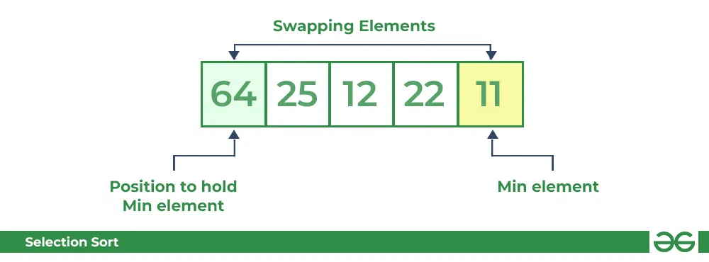
Second Pass:
For the second position, where 25 is present, again traverse the rest of the array in a sequential manner.
After traversing, we found that 12 is the second lowest value in the array and it should appear at the second place in the array, thus swap these values.

Slide 22
Selection Sort Algorithm
import java.io.*;
public class SortAlgorithm {
public static void main(String args[])
{
SortAlgorithm ob = new SortAlgorithm();
int arr[] = {64,25,12,22,11};
ob.sort(arr);
System.out.println("Sorted array");
ob.printArray(arr);
}
void sort(int arr[])
{
int n = arr.length;
// One by one move boundary of unsorted subarray
for (int i = 0; i < n-1; i++)
{
// Find the minimum element in unsorted array
int min_idx = i;
for (int j = i+1; j < n; j++)
if (arr[j] < arr[min_idx])
min_idx = j;
// Swap the found minimum element with the first
// element
int temp = arr[min_idx];
arr[min_idx] = arr[i];
arr[i] = temp;
}
}
// Prints the array
void printArray(int arr[])
{
int n = arr.length;
for (int i=0; i<n; ++i)
System.out.print(arr[i]+" ");
System.out.println();
}
// Driver code to test above
}

Slide 23
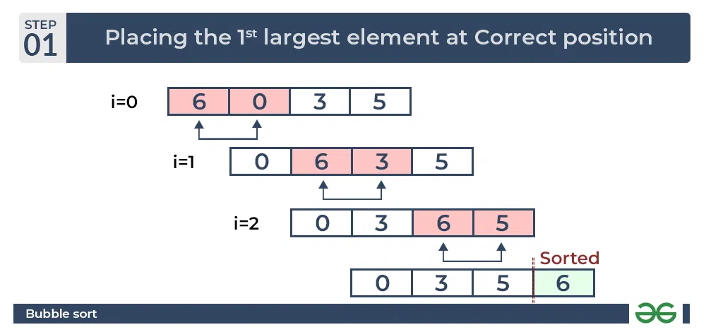
Bubble Sort – Data Structure and Algorithm
Bubble Sort is the simplest sorting algorithm that works by repeatedly swapping the adjacent elements if they are in the wrong order. This algorithm is not suitable for large data sets as its average and worst-case time complexity is quite high.
In Bubble Sort algorithm,
traverse from left and compare adjacent elements and the higher one is placed at right side.
In this way, the largest element is moved to the rightmost end at first.
This process is then continued to find the second largest and place it and so on until the data is sorted.

Slide 24
Bubble Sort – Data Structure and Algorithm
// Swap arr[j] and arr[j+1]
temp = arr[j];
arr[j] = arr[j + 1];
arr[j + 1] = temp;
swapped = true;
}
}
public class BubbleSorting {
public static void main(String[] args) {
// TODO Auto-generated method stub
int arr[] = { 64, 34, 25, 12, 22, 11, 90 };
int n = arr.length;
bubbleSort(arr, n);
System.out.println("Sorted array: ");
printArray(arr, n);
}
// If no two elements were
// swapped by inner loop, then break
if (swapped == false)
break;
}
}
// Function to print an array
static void printArray(int arr[], int size)
{
int i;
for (i = 0; i < size; i++)
System.out.print(arr[i] + " ");
System.out.println();
}
}
// An optimized version of Bubble Sort
static void bubbleSort(int arr[], int n)
{
int i, j, temp;
boolean swapped;
for (i = 0; i < n - 1; i++) {
swapped = false;
for (j = 0; j < n - i - 1; j++) {
if (arr[j] > arr[j + 1]) {

Slide 25
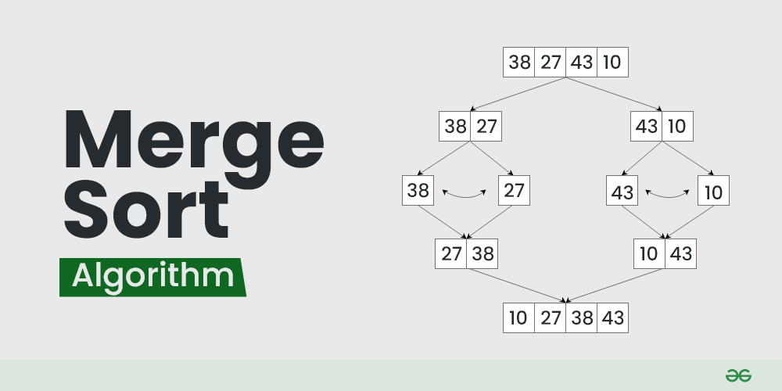
Merge Sort – Data Structure and Algorithms Tutorials
Merge sort is defined as a sorting algorithm that works by dividing an array into smaller subarrays, sorting each subarray, and then merging the sorted subarrays back together to form the final sorted array.
In simple terms, we can say that the process of merge sort is to divide the array into two halves, sort each half, and then merge the sorted halves back together. This process is repeated until the entire array is sorted.

Slide 26
Merge Sort – Data Structure and Algorithms Tutorials
Lets consider an array arr[] = {38, 27, 43, 10}
These sorted subarrays are merged together, and we get bigger sorted subarrays.
This merging process is continued until the sorted array is built from the smaller subarrays.
Initially divide the array into two equal halves:
These subarrays are further divided into two halves. Now they become array of unit length that can no longer be divided and array of unit length are always sorted.
The following diagram shows the complete merge sort process for an example array {38, 27, 43, 10}.

Slide 27
Merge Sort – Data Structure and Algorithms Tutorials
// Merge the temp arrays
// Initial indices of first and second subarrays
int i = 0, j = 0;
// Initial index of merged subarray array
int k = l;
while (i < n1 && j < n2) {
if (L[i] <= R[j]) {
arr[k] = L[i];
i++;
}
else {
arr[k] = R[j];
j++;
}
k++;
}
// Copy remaining elements of L[] if any
while (i < n1) {
arr[k] = L[i];
i++;
k++;
}
import java.io.*;
public class MergeSort {
// Merges two subarrays of arr[].
// First subarray is arr[l..m]
// Second subarray is arr[m+1..r]
void merge(int arr[], int l, int m, int r)
{
// Find sizes of two subarrays to be merged
int n1 = m - l + 1;
int n2 = r - m;
// Create temp arrays
int L[] = new int[n1];
int R[] = new int[n2];
// Copy data to temp arrays
for (int i = 0; i < n1; ++i)
L[i] = arr[l + i];
for (int j = 0; j < n2; ++j)
R[j] = arr[m + 1 + j];

Slide 28
// Copy remaining elements of R[] if any
while (j < n2) {
arr[k] = R[j];
j++;
k++;
}
}
// Main function that sorts arr[l..r] using
// merge()
void sort(int arr[], int l, int r)
{
if (l < r) {
// Find the middle point
int m = l + (r - l) / 2;
// Sort first and second halves
sort(arr, l, m);
sort(arr, m + 1, r);
// Merge the sorted halves
merge(arr, l, m, r);
}
}
// A utility function to print array of size n
static void printArray(int arr[])
{
int n = arr.length;
for (int i = 0; i < n; ++i)
System.out.print(arr[i] + " ");
System.out.println();
}
// Driver code
public static void main(String args[])
{
int arr[] = { 12, 11, 13, 5, 6, 7 };
System.out.println("Given array is");
printArray(arr);
MergeSort ob = new MergeSort();
ob.sort(arr, 0, arr.length - 1);
System.out.println("\nSorted array is");
printArray(arr);
}
}

Slide 29
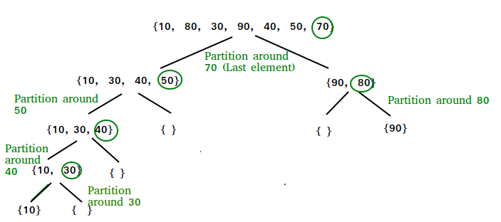
QuickSort – Data Structure and Algorithm
QuickSort is a sorting algorithm based on the Divide and Conquer algorithm that picks an element as a pivot and partitions the given array around the picked pivot by placing the pivot in its correct position in the sorted array.
How does QuickSort work?
The key process in quickSort is a partition(). The target of partitions is to place the pivot (any element can be chosen to be a pivot) at its correct position in the sorted array and put all smaller elements to the left of the pivot, and all greater elements to the right of the pivot.
Partition is done recursively on each side of the pivot after the pivot is placed in its correct position and this finally sorts the array.

Slide 30
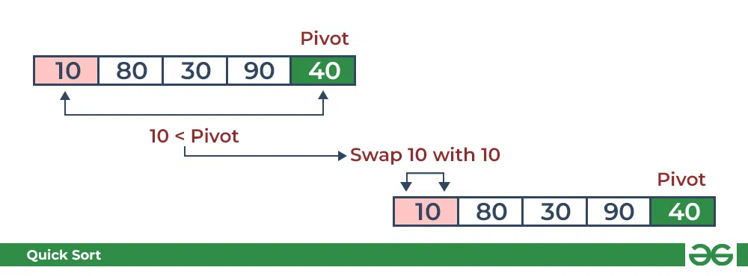
The logic is simple, we start from the leftmost element and keep track of the index of smaller (or equal) elements as i. While traversing, if we find a smaller element, we swap the current element with arr[i]. Otherwise, we ignore the current element.
Let us understand the working of partition and the Quick Sort algorithm with the help of the following example:
Consider: arr[] = {10, 80, 30, 90, 40}.
Compare 10 with the pivot and as it is less than pivot arrange it accrodingly.

Slide 31
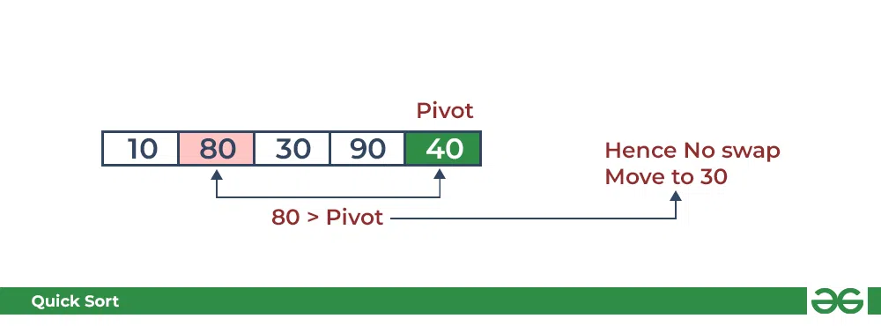
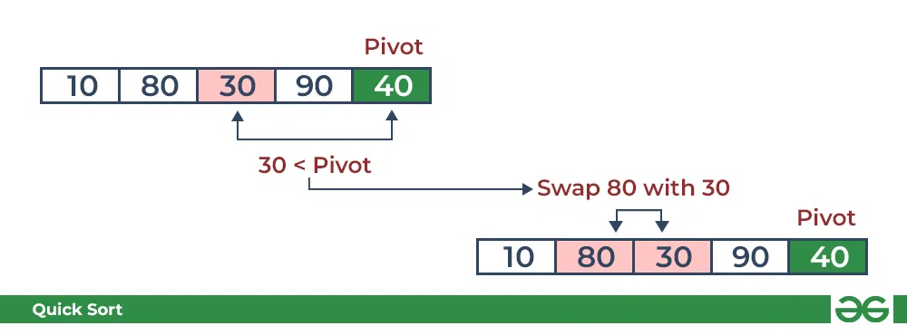
Compare 80 with the pivot. It is greater than pivot.
Compare 30 with pivot. It is less than pivot so arrange it accordingly.

Slide 32
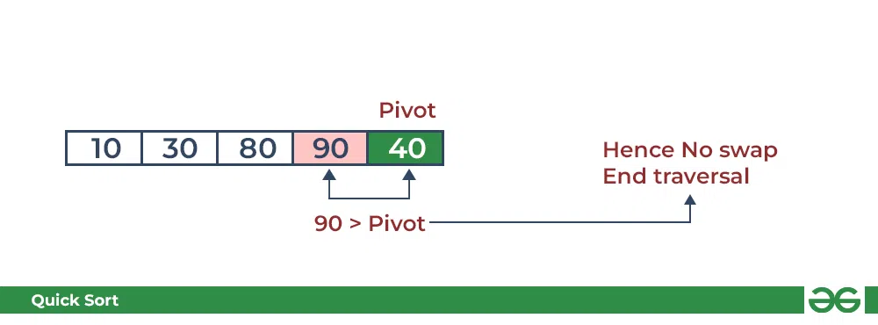
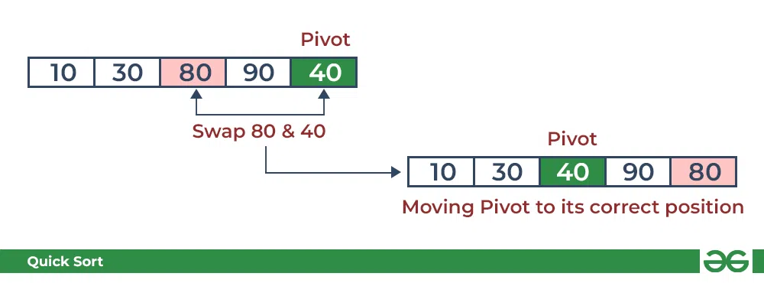
Compare 90 with the pivot. It is greater than the pivot.
Arrange the pivot in its correct position.

Slide 33
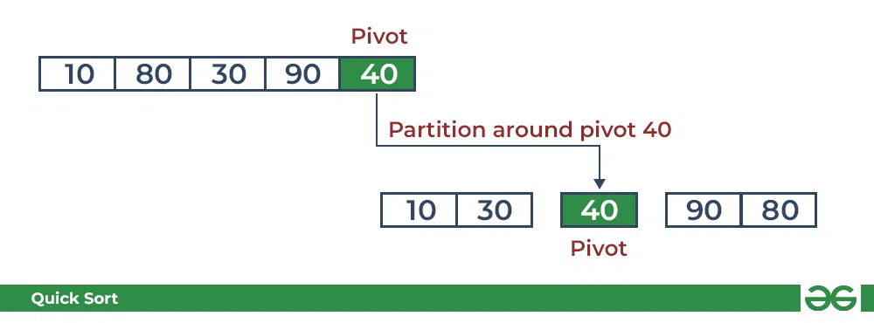
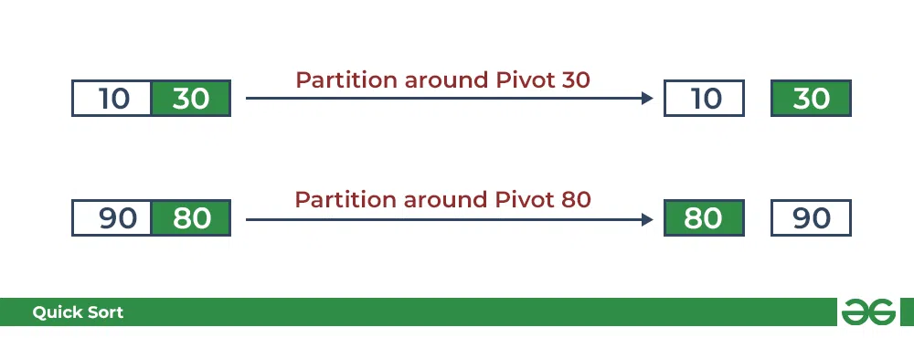
As the partition process is done recursively, it keeps on putting the pivot in its actual position in the sorted array. Repeatedly putting pivots in their actual position makes the array sorted.
Follow the below images to understand how the recursive implementation of the partition algorithm helps to sort the array.
Partitioning of the subarrays:

Slide 34
import java.io.*;
public class QuickSort {
// A utility function to swap two elements
static void swap(int[] arr, int i, int j)
{
int temp = arr[i];
arr[i] = arr[j];
arr[j] = temp;
}
// This function takes last element as pivot,
// places the pivot element at its correct position
// in sorted array, and places all smaller to left
// of pivot and all greater elements to right of pivot
static int partition(int[] arr, int low, int high)
{
// Choosing the pivot
int pivot = arr[high];
// Index of smaller element and indicates
// the right position of pivot found so far
int i = (low - 1);
for (int j = low; j <= high - 1; j++) {
// If current element is smaller than the pivot
if (arr[j] < pivot) {
// Increment index of smaller element
i++;
swap(arr, i, j);
} }
swap(arr, i + 1, high);
return (i + 1);
}

Slide 35
// To print sorted array
public static void printArr(int[] arr)
{
for (int i = 0; i < arr.length; i++) {
System.out.print(arr[i] + " ");
}
}
// Driver Code
public static void main(String[] args)
{
int[] arr = { 10, 7, 8, 9, 1, 5 };
int N = arr.length;
// Function call
quickSort(arr, 0, N - 1);
System.out.println("Sorted array:");
printArr(arr);
}
}
// The main function that implements QuickSort
// arr[] --> Array to be sorted,
// low --> Starting index,
// high --> Ending index
static void quickSort(int[] arr, int low, int high)
{
if (low < high) {
// pi is partitioning index, arr[p]
// is now at right place
int pi = partition(arr, low, high);
// Separately sort elements before
// partition and after partition
quickSort(arr, low, pi - 1);
quickSort(arr, pi + 1, high);
}
}

